Slide 1


2025-2026 Sophomore Course Selection
Class of 2028 - Rising Sophomores

Slide 2
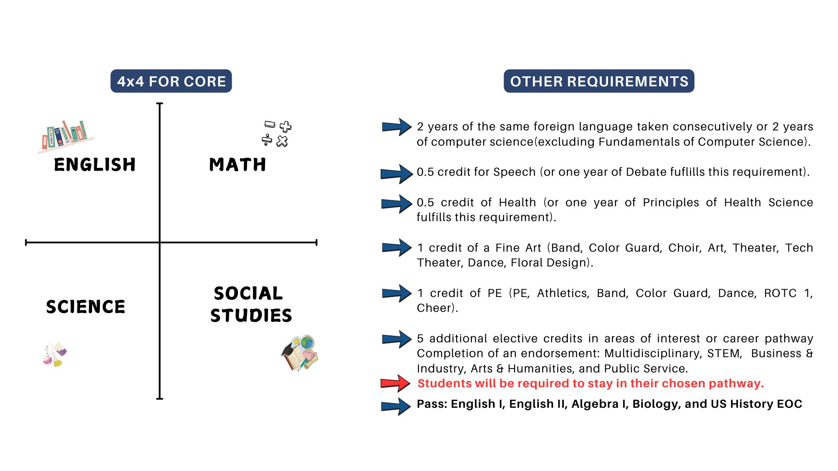
Graduation requirements

Slide 3

Class Rank Policy
Class rank will be calculated for ALL students, but it will not be on the transcripts. A rank letter will be uploaded into your Skyward Portfolios, along with your transcripts.​
Senior year, students will choose to send their rank to colleges or not. The rank letter can be shared with colleges if students choose to share their rank.​
Academy students and Intradistrict transfer students will be ranked among students at the campus they attend.​
GPA will continue to be calculated for all students and will be on the transcripts.​
More information is located in the HS Course Guide in Schoolinks.​

Slide 4
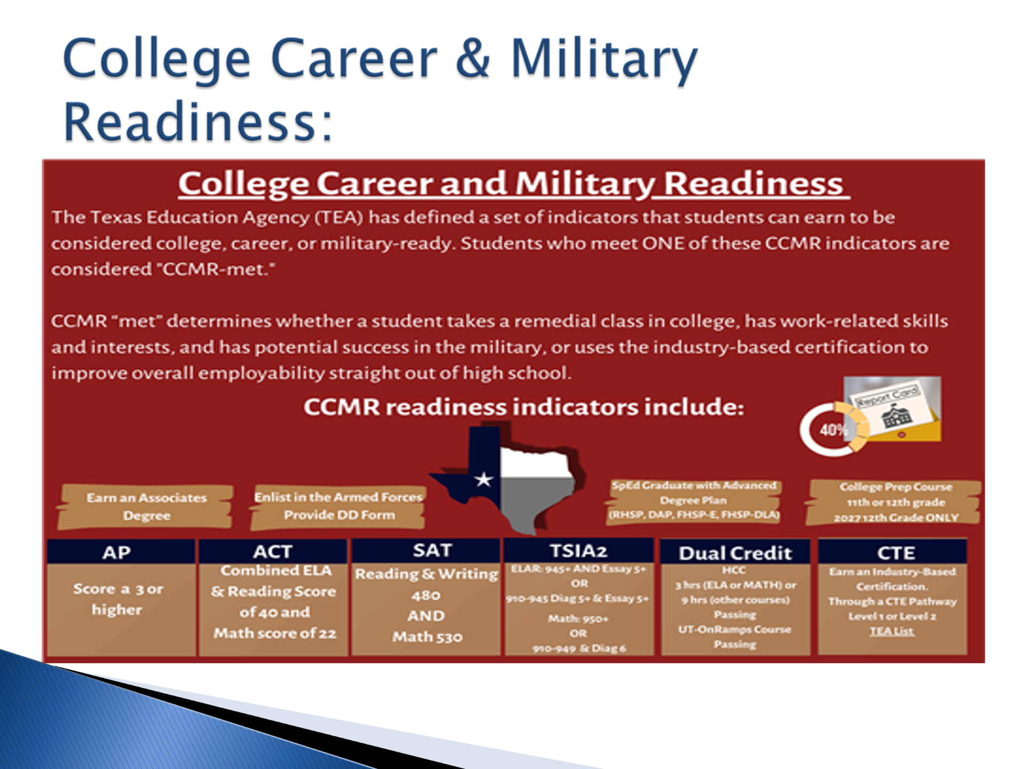
What does it mean to be college ready?

Slide 5

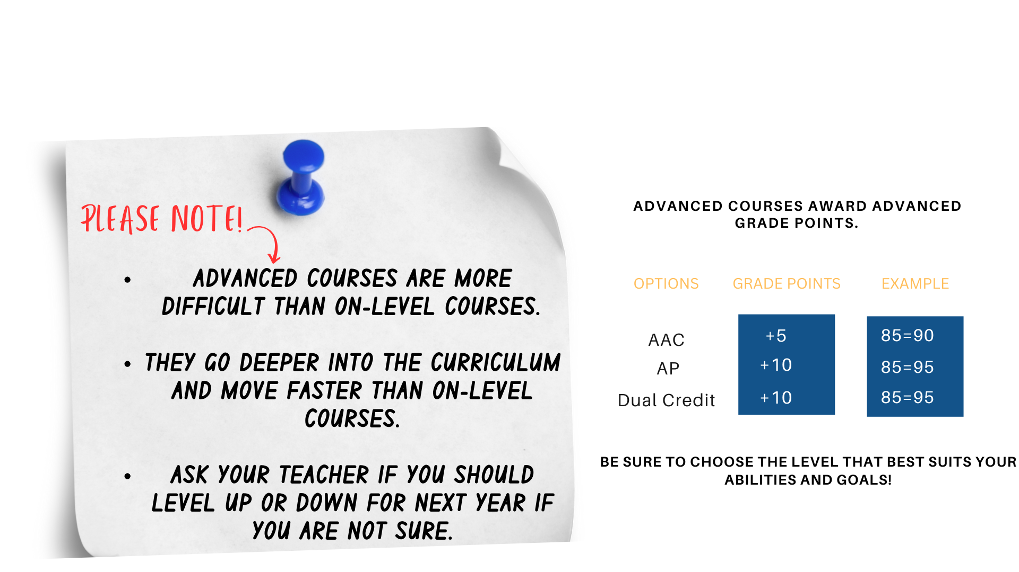
Should I take AAC, AP, or DC?

Slide 6








Summer Courses
Grade Reporting
Students will NOT be moved into their next course for Fall until the grade report has been submitted. For example, all of geometry must be completed by end of July or you will not be moved into Algebra 2.​
Online Courses
Students may enroll in summer courses through UT or TTU online high schools, TxVSN or Dual Credit with HCC.
Restrictions
Associated Costs
Algebra 2 and Pre-Calculus will NOT be approved.
There are costs associated with these summer courses.
Approval Required
All online courses must be approved by your counselor prior to enrolling in course(s). Request approval through Skyward. Check Skyward for approval or denial.
Academy Students
Application Timeline
Academy students will not be approved for math, science or computer science. These must be taken on campus as per the Academy.​
Time Commitment
Summer application will open later in Spring, we do not have any information at this time about summer courses.
These courses must be completed by end of summer, which means logging in 4-5 hours each day!

Slide 7
Course Changes, New Courses, & Updates
Endorsement Pathways Required
  Students will now be required to stay in a pathway throughout their high school career.
Psychology Offerings
  AAC Psych and AP Psych will be available to 10th grade students again, but they must be taken together for the full year.
Water Polo Code
  There is now a specific course code for students participating in the Water Polo sport.
AP Seminar Contract
  A contract agreement is now required to the AP exam
Barbering Added
  Barbering has been added to the Cosmetology Pathway at the Reese Center.
Cybersecurity Pathway
  Any 2 of the following courses: AP Computer Science Principles, AP Computer Science, Computer Science III
  Foundations of Cybersecurity
  Cybersecurity Capstone
Human Service Pathway has changed:​
    Principles of Human Services​
    Lifetime Nutrition/Interpersonal Studies​
    Human Growth & Development
    Counseling & Mental Health​

Slide 8



Dual Enrollment - UT OnRamps
Dual Enrollment Basics
Inquiry-Based Learning
Course Options for 10th Grade
Students earn both high school and college credit through UT OnRamps. These courses are weighted at the AP level. Currently there is no cost for these courses.
**No forms required, just choose course on course selection sheet.
UT OnRamps courses utilize an inquiry-based learning approach, which is student-driven rather than teacher-driven. This non-traditional learning style may not be suitable for everyone, so students should choose wisely.
The UT OnRamps course options available for 10th grade students include Algebra 2, Pre-Calculus (if Algebra 2 has been completed), and Chemistry.
AAC/AP/Dual Credit/UT OnRamps Information Sheet

Slide 9
Dual Credit - HCC Courses
New Dual Credit Courses for 10th Grade
Enrollment Process
Course Weighting
Please look for the email from Ms. Powis on 1/9/25 for the step-by-step process to enroll in these Dual Credit courses. There is paperwork and other requirements to complete with the HCC courses .
These courses are weighted as AP and are rigorous.
FBISD will now allow 10th grade students to take the following Dual Credit courses: Speech, Sociology, and Psychology.
Recommended Courses
Student Eligibility
We have Speech and Sociology available on our campus, so these would be the recommended Dual Credit courses. This way students have the support of our teachers on our campus. Anything online or in the summer would be with a college professor.
Counselors will review student grades and 8th grade PSAT scores to ensure students are ready for these Dual Credit courses.

Slide 10






Reese Center Applications
If you are interested in earning a Certification that could lead to a career – apply to Reese!​
Students have 6 programs that they can apply to for their 10th grade year – 2 of these programs are 3 years and can only be applied to for 10th grade:​
10th Grade
10th Grade
10th Grade
10th Grade ONLY
10th Grade ONLY
10th Grade

Slide 11

Scan QR
for Reese Application:

Slide 12
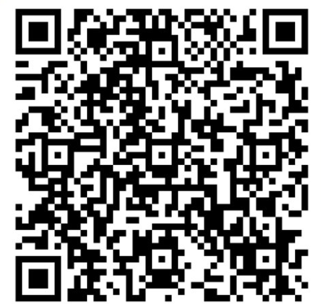
Interested in AVID?
Application closed on 1/24/2025, but interested students should see Ms. Ardoin in room 131

Slide 13





Need to Knows!
Level Down Approval
Level downs will not be approved until the 4th week of school
Minimum Grade for Level Down
Students must have a grade below 75.​
Level Up Approval
Level ups – must be done immediately!​
AB Calculus​ - BC Calculus (S1 only) -​ AP Biology - On Ramps Biology​ AP Chemistry​ - Physics C​ - Physics 2​ - Levels 4 and 5 of Foreign Language​ - Computer Science courses​ - AP Seminar and AP Research -​ & - Decathlon (called Multi-variable Calculus)
​Choosing these courses are a full year commitment.​
Courses with No Level Changes

Slide 14
Course Selection Process
Complete course selection form
  Complete the course selection form in its entirety, listing at least 3 alternate courses. Write clearly using your full name along with your student ID number.
Use the Universal course selection sheet
  Use the Universal course selection sheet to guide you through the course selection process and make informed choices.
Access the FBISD Course Guide in Schoolinks
  The FBISD Course Guide located in Schoolinks, provides information on course prerequisites, descriptions, credit awarded, and how the course is weighted (AAC, AP).
Courses will be added to Career Planner in Schoolinks
  Course requests will be added to Career Planner in Schoolinks, not Skyward.
Return Forms to Counselor
  Course selection forms are to be turned into the counselor suites room 401 and 402 with parent signature.​
Schoolinks will be available from January 27 to February 14, 2025.
  What is added in Schoolinks will become your course requests.​
Course Verification Window is from March 3-7
  Verify your courses in Skyward Family Access when the window opens March 3 - 7. This is the only opportunity to make changes to your choices. Like this year, absolutely no schedule will be made after March 7, 2025, unless it is a counselor error.​

Slide 15
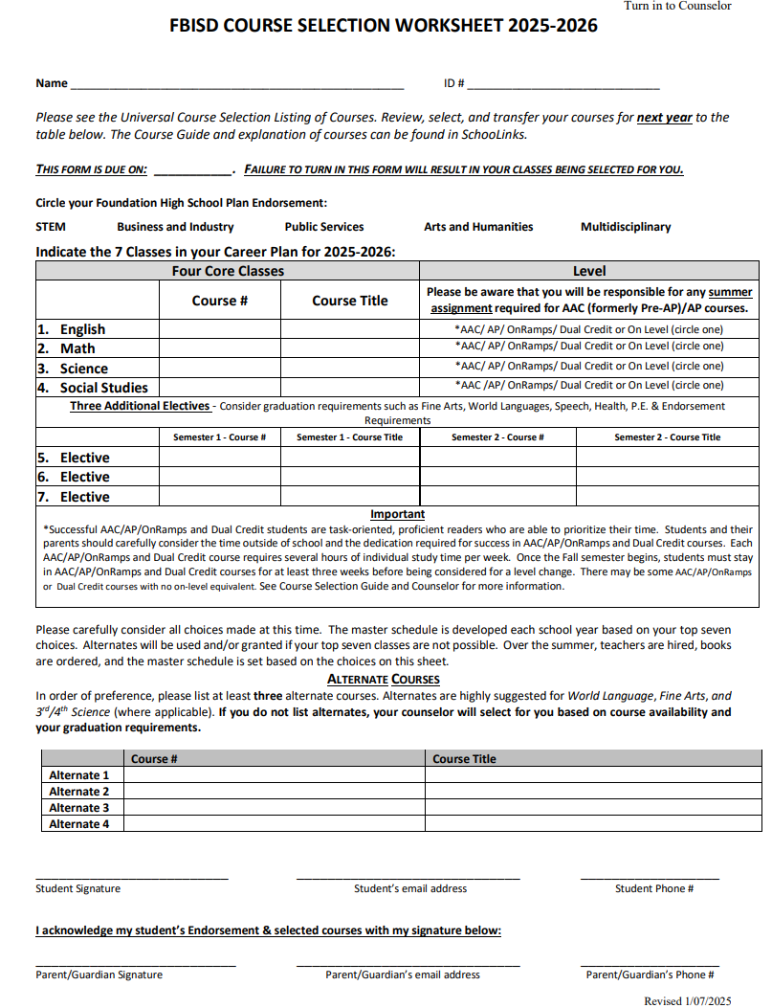
Make sure you Select 4 core courses and 3 elective courses
Please choose 3 alternate courses to complete your course selection
Be sure one of your courses is your endorsement elective

Slide 16






Reminders
Schoology Course Access
Turn in Form Immediately
This PowerPoint will be available in the EHS Counselor & CCR Schoology Course with access code 7NPB-W4H5-RVN29.
Turn in your course selection form as soon as possible in rooms 401 and 402! If you do not turn in a form and there is nothing in Schoolinks, your counselor will add courses for you!​
Course Selection
Select 4 core courses, 3 elective courses, and 3 alternate courses to complete your course selection
Be sure you have your Pathway course
we will be checking these and adding any missing courses.​
Parent Signature Required
Courses Selection Deadlines
Parent signature is required on the course selection form.
All courses must be added to Schoolinks no later than February 14, 2025.​Course Verification Window is from March 3-7.
ABSOLUTLEY NO SCHEDULE CHANGES AFTER MARCH 7, 2025!​

